Slide 1
Turning Linear Models into Nonlinear Models using Kernel Methods (Contd)
CS771: Introduction to Machine Learning
Piyush Rai

Slide 2
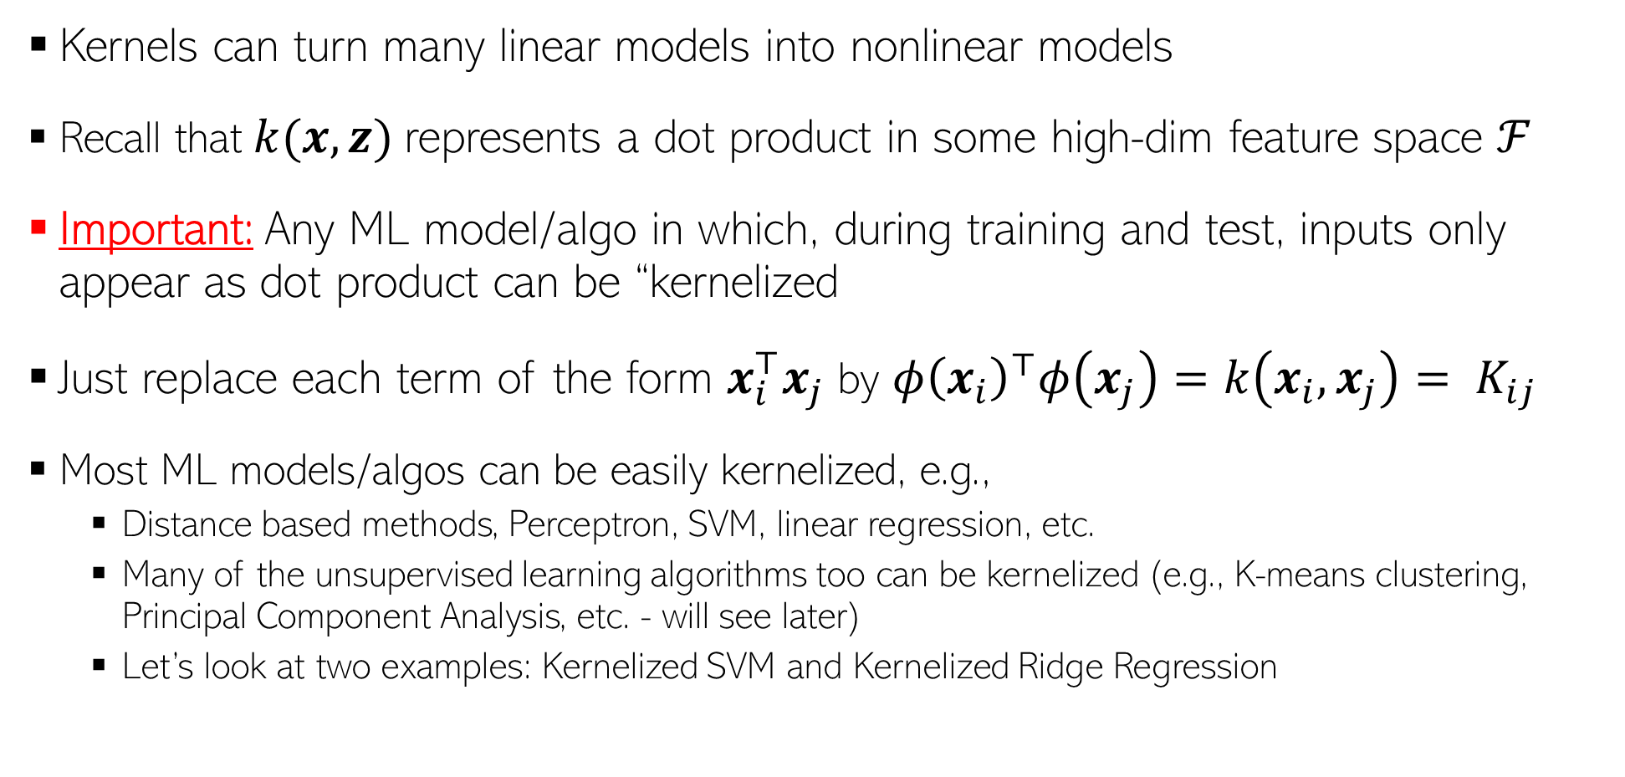
Using Kernels
Kernels can turn many linear models into nonlinear models
Recall that $k(x, z)$represents a dot product in some high-dim feature space $ℱ$
Important: Any ML model/algo in which, during training and test, inputs only appear as dot product can be “kernelized
Just replace each term of the form $x_{i}^{⊤}x_{j}$ by ${φ\left(x_{i}\right)}^{⊤}φ\left(x_{j}\right)=k\left(x_{i},x_{j}\right)= K_{ij}$
Most ML models/algos can be easily kernelized, e.g.,
Distance based methods, Perceptron, SVM, linear regression, etc.
Many of the unsupervised learning algorithms too can be kernelized (e.g., K-means clustering, Principal Component Analysis, etc. - will see later)
Let’s look at two examples: Kernelized SVM and Kernelized Ridge Regression

Slide 3




An Aside: Kernelizing a Euclidean Distance
Many algorithms, e.g., LwP, KNN, etc. use Euclidean distances, e.g.,
This can be kernelized as well by replacing the above norms and inner products by their kernelized versions, assuming a kernel $k$ with feature map $φ$
$$d\left(a,b\right)={\left\|a−b\right\|}^{2}$$
$$={\left\|a\right\|}^{2}+{\left\|b\right\|}^{2}−2a^{⊤}b$$
$$=a^{⊤}a+b^{⊤}b−2a^{⊤}b$$
$$d\left(φ(a),φ(b)\right)={\left\|φ(a)−φ(b)\right\|}^{2}$$
$$={φ(a)}^{⊤}φ(a)+{φ(b)}^{⊤}φ(b)−2{φ(a)}^{⊤}φ(b)$$
$$=k(a,a)+k(b,b)−2k(a,b)$$

Slide 4
Nonlinear SVM using Kernels

Slide 5
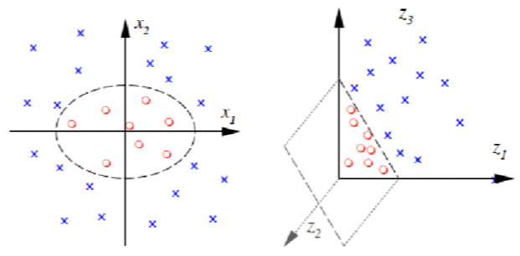

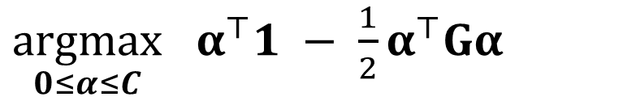
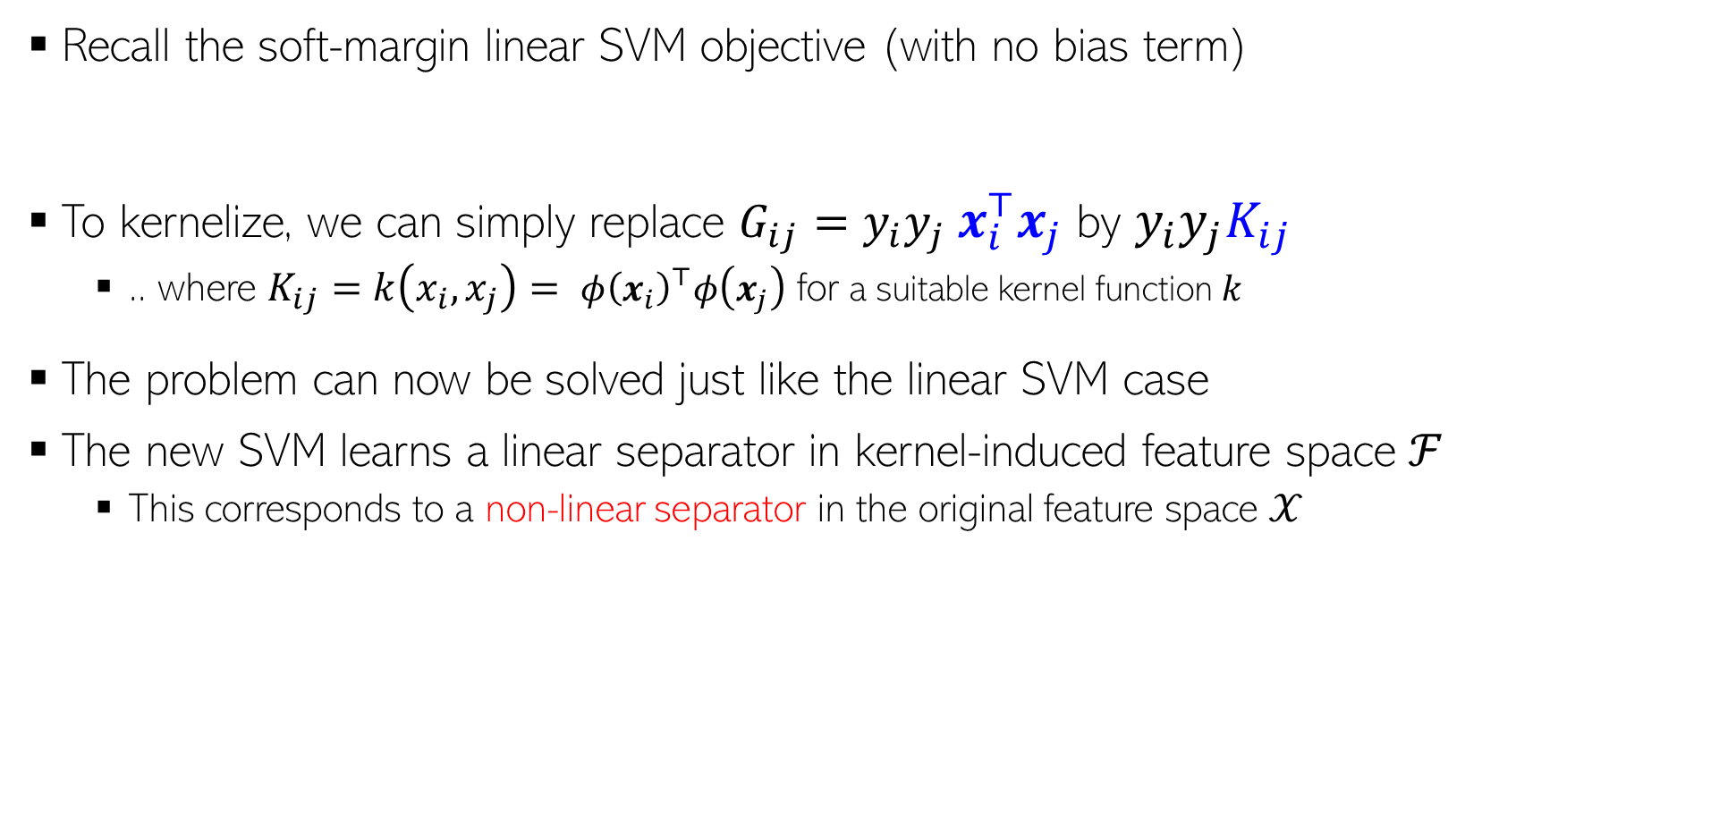
Kernelized SVM Training
Inputs only appear as dot products ☺
Recall the soft-margin linear SVM objective (with no bias term)
To kernelize, we can simply replace $G_{ij}=y_{i}y_{j}$ $x_{i}^{⊤}x_{j}$ by $y_{i}y_{j}K_{ij}$
.. where $K_{ij}=k\left(x_{i},x_{j}\right)= {φ\left(x_{i}\right)}^{⊤}φ\left(x_{j}\right)$ for a suitable kernel function $k$
The problem can now be solved just like the linear SVM case
The new SVM learns a linear separator in kernel-induced feature space ℱ
This corresponds to a non-linear separator in the original feature space $𝒳$
$\underset{0≤α≤C}{argmax}$ $α^{⊤}1 − \frac{1}{2}α^{⊤}Gα$
$G_{ij}=y_{i}y_{j}$ $x_{i}^{⊤}x_{j}$

Slide 6
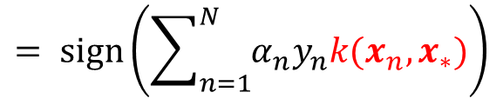
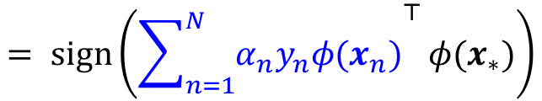

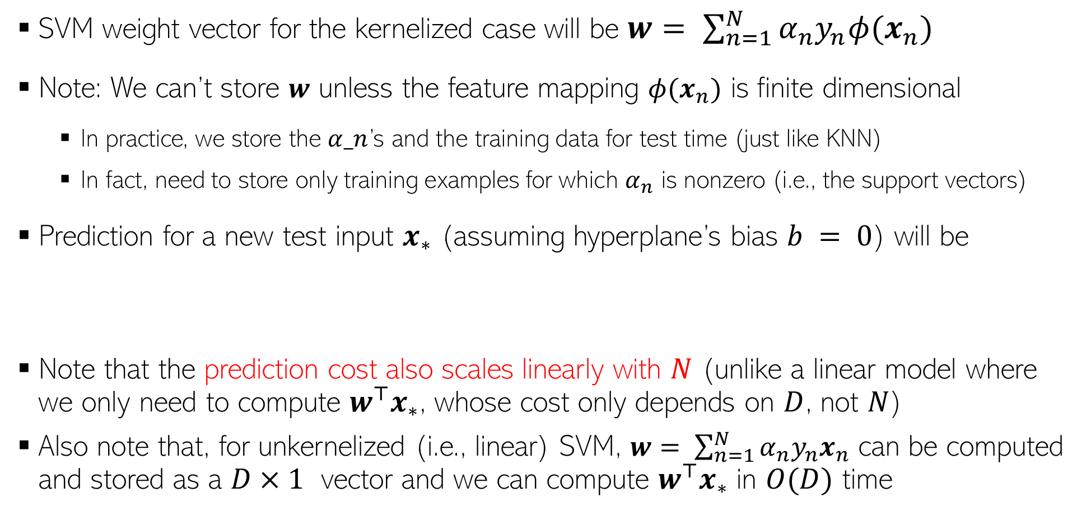
Kernelized SVM Prediction
SVM weight vector for the kernelized case will be $w= \sum_{n=1}^{N}{α_{n}y_{n}φ(x_{n})}$
Note: We can’t store $w$ unless the feature mapping $φ(x_{n})$ is finite dimensional
In practice, we store the $α_n$’s and the training data for test time (just like KNN)
In fact, need to store only training examples for which $α_{n}$ is nonzero (i.e., the support vectors)
Prediction for a new test input $x_{∗}$ (assuming hyperplane’s bias $b = 0$) will be
Note that the prediction cost also scales linearly with $N$ (unlike a linear model where we only need to compute $w^{⊤}x_{∗}$, whose cost only depends on $D$, not $N$)
Also note that, for unkernelized (i.e., linear) SVM, $w= \sum_{n=1}^{N}{α_{n}y_{n}x_{n}}$ can be computed and stored as a $D×1$ vector and we can compute $w^{⊤}x_{∗}$ in $O(D)$ time
$$= sign\left({\sum_{n=1}^{N}{α_{n}y_{n}φ(x_{n})}}^{⊤}{φ(x}_{∗})\right)$$
$$= sign\left(\sum_{n=1}^{N}{α_{n}y_{n}k(x_{n},x_{∗})}\right)$$
$$y_{∗}= sign(w^{⊤}{φ(x}_{∗}))$$

Slide 7
Nonlinear Ridge Regression using Kernels

Slide 8
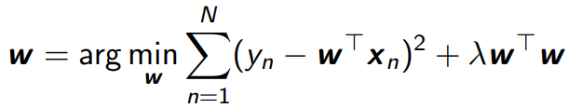




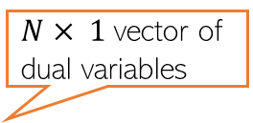

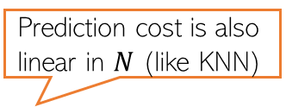
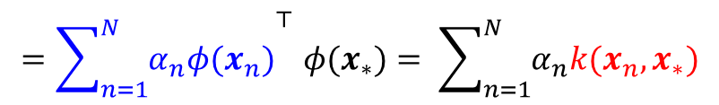
Kernelized Ridge Regression
Recall the ridge regression problem:
The solution to this problem was
Can use matrix inversion lemma
Using the lemma, can rewrite $w$ as
Kernelized weight vector will be $w= \sum_{n=1}^{N}{α_{n}φ(x_{n})}$
Prediction for a test input $x_{∗}$will be $w^{⊤}{φ(x}_{∗})$
Inputs don’t appear to be as inner product. No hope of kernelization?
They do; with a bit of algebra ☺
$N× 1$vector of dual variables
Note: Not sparse unlike SVM
where
Prediction cost is also linear in $N$ (like KNN)
$${=\sum_{n=1}^{N}{α_{n}φ(x_{n})}}^{⊤}{φ(x}_{∗})= \sum_{n=1}^{N}{α_{n}k(x_{n},x_{∗})}$$

Slide 9
Speeding-up Kernel Methods

Slide 10
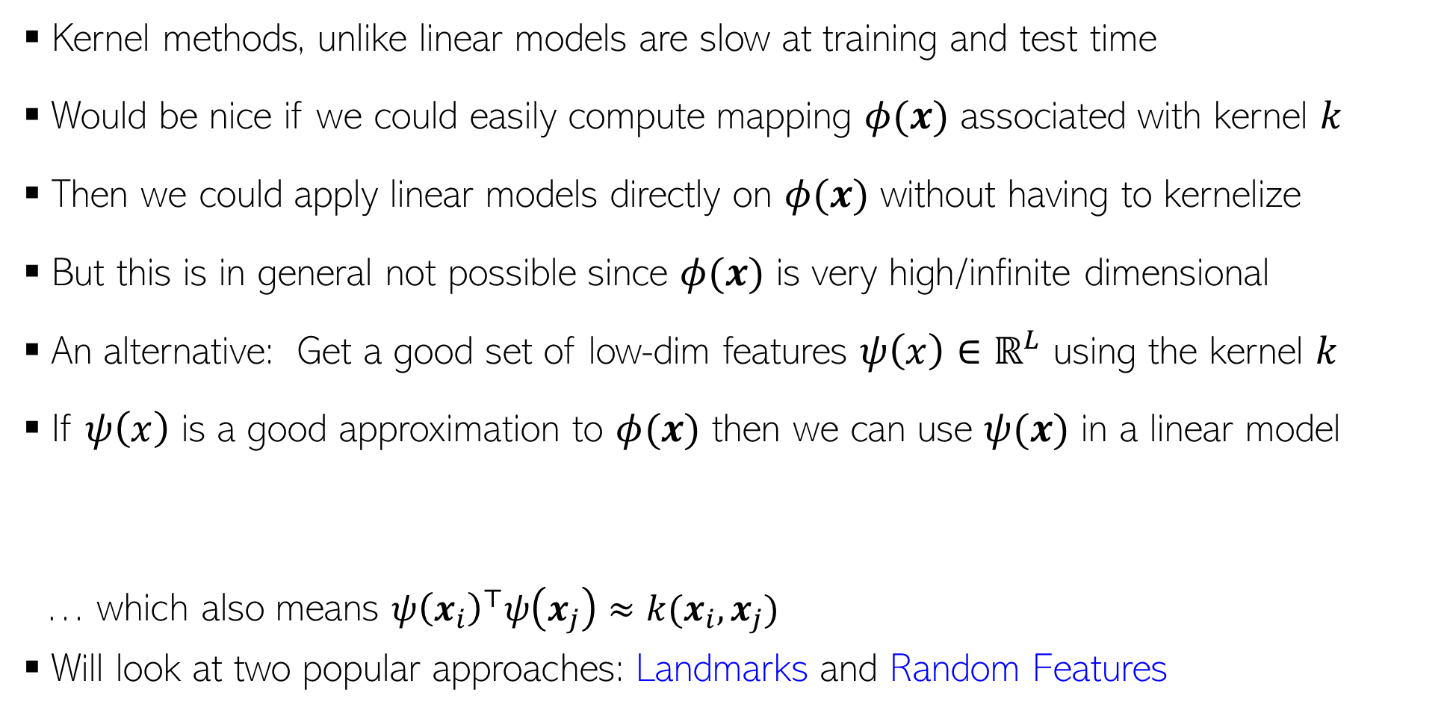
Speeding-up Kernel Methods
Kernel methods, unlike linear models are slow at training and test time
Would be nice if we could easily compute mapping $φ(x)$ associated with kernel $k$
Then we could apply linear models directly on $φ(x)$ without having to kernelize
But this is in general not possible since $φ(x)$ is very high/infinite dimensional
An alternative: Get a good set of low-dim features $ψ\left(x\right)∈ℝ^{L}$ using the kernel $k$
If $ψ\left(x\right)$ is a good approximation to $φ(x)$ then we can use $ψ(x)$ in a linear model
… which also means ${ψ\left(x_{i}\right)}^{⊤}ψ\left(x_{j}\right)≈k(x_{i},x_{j})$
Will look at two popular approaches: Landmarks and Random Features
$$Goodness Criterion: {ψ\left(x_{i}\right)}^{⊤}ψ\left(x_{j}\right)≈{φ\left(x_{i}\right)}^{⊤}φ\left(x_{j}\right)$$

Slide 11
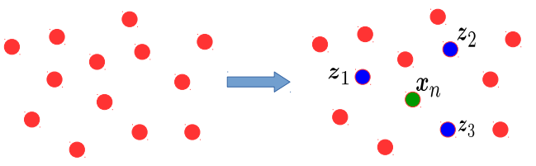
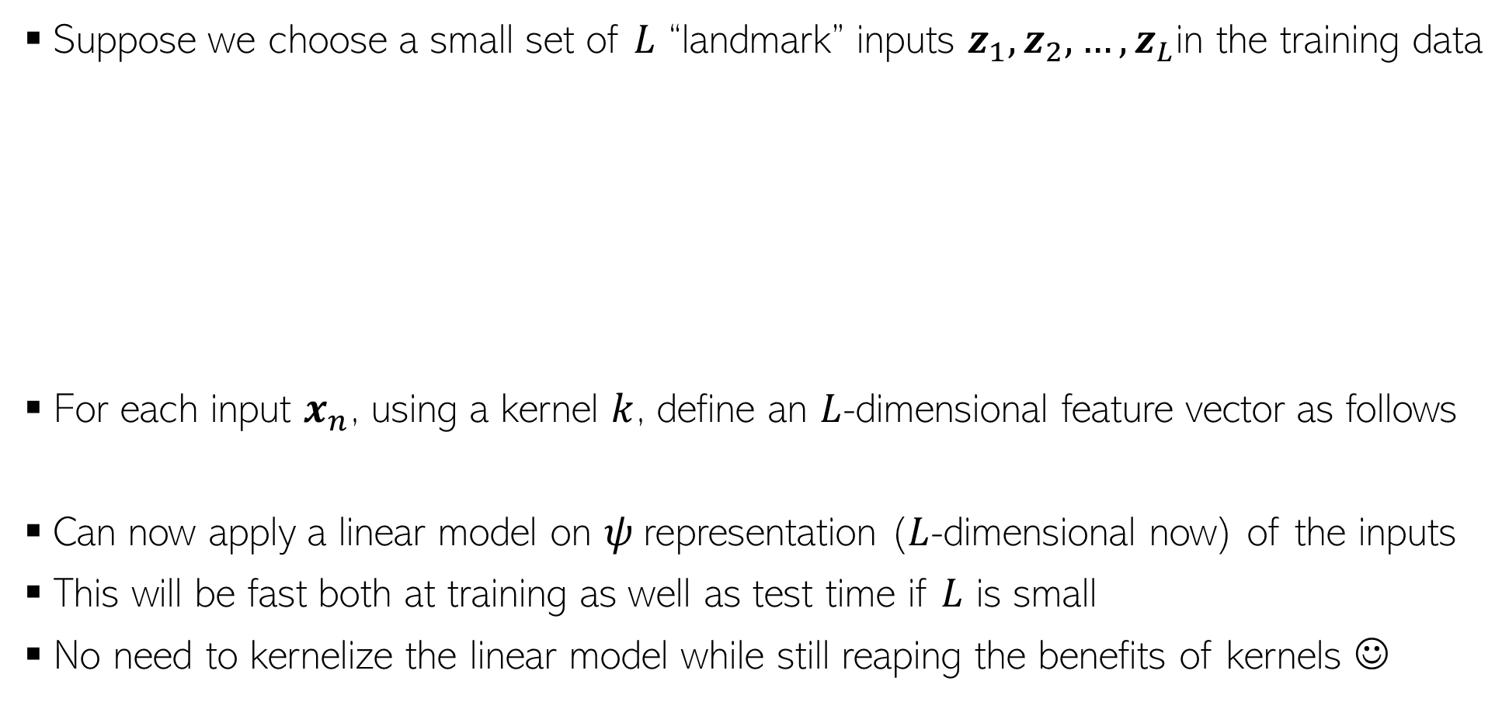
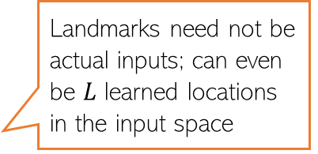
Extracting Features using Kernels: Landmarks
Suppose we choose a small set of $L$ “landmark” inputs $z_{1},z_{2},…, z_{L}$in the training data
For each input $x_{n}$, using a kernel $k$, define an $L$-dimensional feature vector as follows
Can now apply a linear model on $ψ$representation ($L$-dimensional now) of the inputs
This will be fast both at training as well as test time if $L$ is small
No need to kernelize the linear model while still reaping the benefits of kernels ☺
Landmarks need not be actual inputs; can even be $L$ learned locations in the input space
$$ψ\left(x_{n}\right)=\left[k\left(z_{1},x_{n}\right),k\left(z_{2},x_{n}\right), k\left(z_{3},x_{n}\right)\right]∈ℝ^{3}$$
$$ψ\left(x_{n}\right)=\left[k\left(z_{1},x_{n}\right),k\left(z_{2},x_{n}\right),…,k\left(z_{L},x_{n}\right)\right]∈ℝ^{L}$$

Slide 12
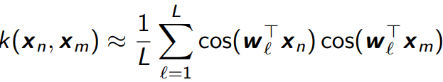

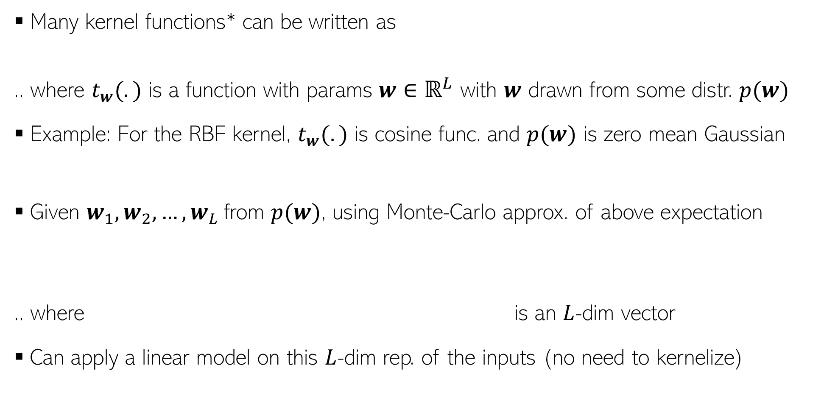
Extracting Feat. using Kernels: Random Features
Many kernel functions* can be written as
.. where $t_{w}(.)$ is a function with params $w∈ℝ^{L}$ with $w$ drawn from some distr. $p(w)$
Example: For the RBF kernel, $t_{w}(.)$ is cosine func. and $p(w)$ is zero mean Gaussian
Given $w_{1},w_{2},…, w_{L}$from $p(w)$, using Monte-Carlo approx. of above expectation
.. where is an $L$-dim vector
Can apply a linear model on this $L$-dim rep. of the inputs (no need to kernelize)
*Random Features for Large-Scale Kernel Machines (Ben and Retch, NIPS 2007. Note: This paper actually won the test-of-time award at NIPS 2017)

Slide 13
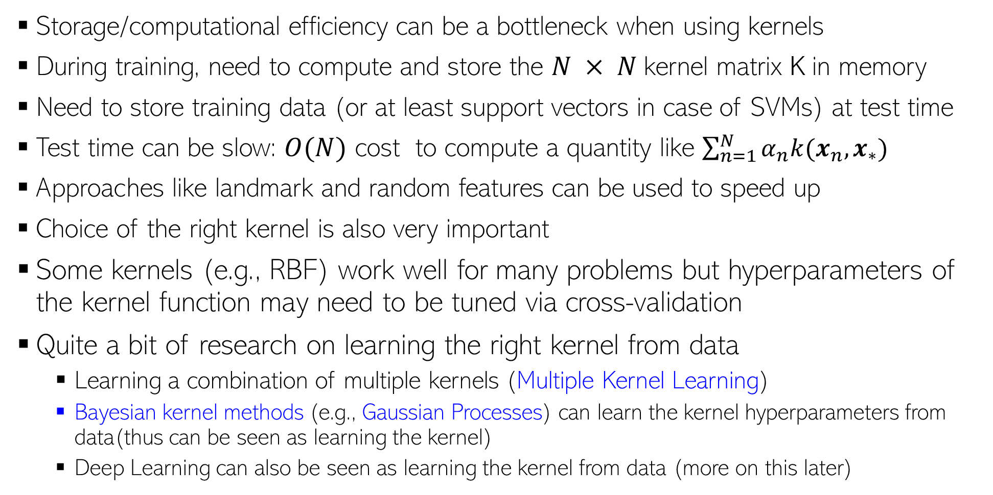
Learning with Kernels: Some Aspects
Storage/computational efficiency can be a bottleneck when using kernels
During training, need to compute and store the $N × N$kernel matrix K in memory
Need to store training data (or at least support vectors in case of SVMs) at test time
Test time can be slow: $O(N)$ cost to compute a quantity like $\sum_{n=1}^{N}{α_{n}k(x_{n},x_{∗})}$
Approaches like landmark and random features can be used to speed up
Choice of the right kernel is also very important
Some kernels (e.g., RBF) work well for many problems but hyperparameters of the kernel function may need to be tuned via cross-validation
Quite a bit of research on learning the right kernel from data
Learning a combination of multiple kernels (Multiple Kernel Learning)
Bayesian kernel methods (e.g., Gaussian Processes) can learn the kernel hyperparameters from data(thus can be seen as learning the kernel)
Deep Learning can also be seen as learning the kernel from data (more on this later)
Also, a lot of recent work on connections between kernel methods and deep learning

Slide 14
Coming up next
Unsupervised learning

